Slide 1
Chapter 5: CPU Scheduling

Slide 2
Chapter 5: CPU Scheduling
Basic Concepts
Scheduling Criteria
Scheduling Algorithms
Multiple-Processor Scheduling
Real-Time Scheduling
Thread Scheduling
Operating Systems Examples
Java Thread Scheduling
Algorithm Evaluation

Slide 3
Basic Concepts
Maximum CPU utilization obtained with multiprogramming
CPU–I/O Burst Cycle – Process execution consists of a cycle of CPU execution and I/O wait
CPU burst distribution

Slide 4

Alternating Sequence of CPU And I/O Bursts

Slide 5

Histogram of CPU-burst Times

Slide 6
CPU Scheduler
Selects from among the processes in memory that are ready to execute, and allocates the CPU to one of them
CPU scheduling decisions may take place when a process:
  1. Switches from running to waiting state
  2. Switches from running to ready state
  3. Switches from waiting to ready
  4. Terminates
Scheduling under 1 and 4 is nonpreemptive
All other scheduling is preemptive

Slide 7
Dispatcher
Dispatcher module gives control of the CPU to the process selected by the short-term scheduler; this involves:
  switching context
  switching to user mode
  jumping to the proper location in the user program to restart that program
Dispatch latency – time it takes for the dispatcher to stop one process and start another running

Slide 8
Scheduling Criteria
CPU utilization – keep the CPU as busy as possible
Throughput – # of processes that complete their execution per time unit
Turnaround time – amount of time to execute a particular process
Waiting time – amount of time a process has been waiting in the ready queue
Response time – amount of time it takes from when a request was submitted until the first response is produced, not output (for time-sharing environment)

Slide 9
Optimization Criteria
Max CPU utilization
Max throughput
Min turnaround time
Min waiting time
Min response time

Slide 10
First-Come, First-Served (FCFS) Scheduling
Process Burst Time
P₁ 24
P₂ 3
P₃ 3
Suppose that the processes arrive in the order: P₁ , P₂ , P₃
The Gantt Chart for the schedule is:
Waiting time for P₁ = 0; P₂ = 24; P₃ = 27
Average waiting time: (0 + 24 + 27)/3 = 17
P₁
P₂
P₃
0
24
27
30

Slide 11
FCFS Scheduling (Cont.)
Suppose that the processes arrive in the order
P₂ , P₃ , P₁
The Gantt chart for the schedule is:
Waiting time for P₁ = 6; P₂ = 0; P₃ = 3
Average waiting time: (6 + 0 + 3)/3 = 3
Much better than previous case
Convoy effect short process behind long process
P₂
P₃
P₁
0
3
6
30

Slide 12
Shortest-Job-First (SJF) Scheduling
Associate with each process the length of its next CPU burst. Use these lengths to schedule the process with the shortest time
Two schemes:
  nonpreemptive – once CPU given to the process it cannot be preempted until completes its CPU burst
  preemptive – if a new process arrives with CPU burst length less than remaining time of current executing process, preempt. This scheme is know as the
  Shortest-Remaining-Time-First (SRTF)
SJF is optimal – gives minimum average waiting time for a given set of processes

Slide 13
Example of Non-Preemptive SJF
Process Arrival Time Burst Time
P₁ 0.0 7
P₂ 2.0 4
P₃ 4.0 1
P₄ 5.0 4
SJF (non-preemptive)
Average waiting time = (0 + 6 + 3 + 7)/4 = 4
P₁
P₃
P₂
P₄
0
3
7
8
12
16

Slide 14
Example of Preemptive SJF
Process Arrival Time Burst Time
P₁ 0.0 7
P₂ 2.0 4
P₃ 4.0 1
P₄ 5.0 4
SJF (preemptive)
Average waiting time = (9 + 1 + 0 +2)/4 = 3
P₁
P₂
P₃
P₂
P₄
P₁
0
2
4
5
7
11
16

Slide 15


Determining Length of Next CPU Burst
Can only estimate the length
Can be done by using the length of previous CPU bursts, using exponential averaging

Slide 16

Prediction of the Length of the Next CPU Burst

Slide 17
Examples of Exponential Averaging
α =0
  τ_{n+1} = τ_{n}
  Recent history does not count
α =1
  τ_{n+1} = α t_{n}
  Only the actual last CPU burst counts
If we expand the formula, we get:
    τ_{n+1} = α t_{n}+(1 - α)α t_{n} -1 + …
    +(1 - α )^{j} α t_{n} _{-j} + …
    +(1 - α )^{n +1} τ₀
Since both α and (1 - α) are less than or equal to 1, each successive term has less weight than its predecessor

Slide 18
Priority Scheduling
A priority number (integer) is associated with each process
The CPU is allocated to the process with the highest priority (smallest integer ≡ highest priority)
  Preemptive
  nonpreemptive
SJF is a priority scheduling where priority is the predicted next CPU burst time
Problem ≡ Starvation – low priority processes may never execute
Solution ≡ Aging – as time progresses increase the priority of the process

Slide 19
Round Robin (RR)
Each process gets a small unit of CPU time (time quantum), usually 10-100 milliseconds. After this time has elapsed, the process is preempted and added to the end of the ready queue.
If there are n processes in the ready queue and the time quantum is q, then each process gets 1/n of the CPU time in chunks of at most q time units at once. No process waits more than (n-1)q time units.
Performance
  q large ⇒ FIFO
  q small ⇒ q must be large with respect to context switch, otherwise overhead is too high

Slide 20
Example of RR with Time Quantum = 20
Process Burst Time
P₁ 53
P₂ 17
P₃ 68
P₄ 24
The Gantt chart is:
Typically, higher average turnaround than SJF, but better response
P₁
P₂
P₃
P₄
P₁
P₃
P₄
P₁
P₃
P₃
0
20
37
57
77
97
117
121
134
154
162

Slide 21

Time Quantum and Context Switch Time

Slide 22

Turnaround Time Varies With The Time Quantum

Slide 23
Multilevel Queue
Ready queue is partitioned into separate queues:
foreground (interactive)
background (batch)
Each queue has its own scheduling algorithm
  foreground – RR
  background – FCFS
Scheduling must be done between the queues
  Fixed priority scheduling; (i.e., serve all from foreground then from background). Possibility of starvation.
  Time slice – each queue gets a certain amount of CPU time which it can schedule amongst its processes; i.e., 80% to foreground in RR
  20% to background in FCFS

Slide 24

Multilevel Queue Scheduling

Slide 25
Multilevel Feedback Queue
A process can move between the various queues; aging can be implemented this way
Multilevel-feedback-queue scheduler defined by the following parameters:
  number of queues
  scheduling algorithms for each queue
  method used to determine when to upgrade a process
  method used to determine when to demote a process
  method used to determine which queue a process will enter when that process needs service

Slide 26
Example of Multilevel Feedback Queue
Three queues:
  Q₀ – RR with time quantum 8 milliseconds
  Q₁ – RR time quantum 16 milliseconds
  Q₂ – FCFS
Scheduling
  A new job enters queue Q₀ which is served FCFS. When it gains CPU, job receives 8 milliseconds. If it does not finish in 8 milliseconds, job is moved to queue Q₁.
  At Q₁ job is again served FCFS and receives 16 additional milliseconds. If it still does not complete, it is preempted and moved to queue Q₂.

Slide 27

Multilevel Feedback Queues

Slide 28
Multiple-Processor Scheduling
CPU scheduling more complex when multiple CPUs are available
Homogeneous processors within a multiprocessor
Load sharing
Asymmetric multiprocessing – only one processor accesses the system data structures, alleviating the need for data sharing

Slide 29
Real-Time Scheduling
Hard real-time systems – required to complete a critical task within a guaranteed amount of time
Soft real-time computing – requires that critical processes receive priority over less fortunate ones

Slide 30
Thread Scheduling
Local Scheduling – How the threads library decides which thread to put onto an available LWP
Global Scheduling – How the kernel decides which kernel thread to run next

Slide 31
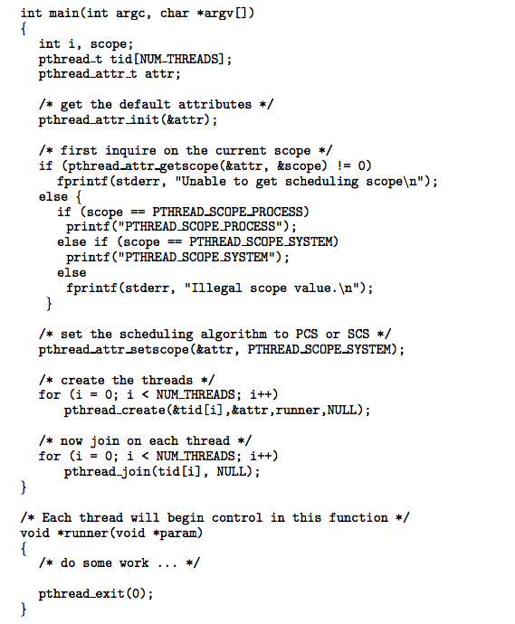
Pthread Scheduling API

Slide 32
Operating System Examples
Solaris scheduling
Windows XP scheduling
Linux scheduling

Slide 33
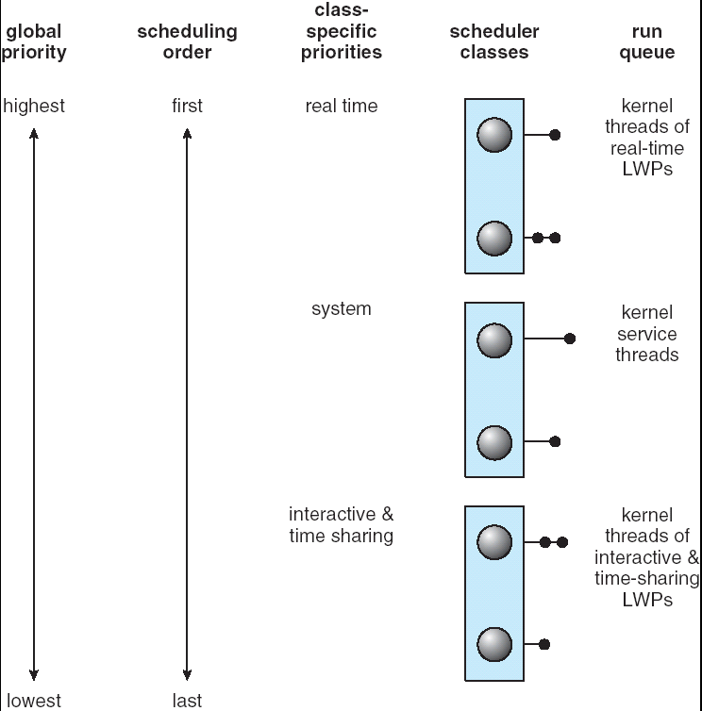
Solaris Scheduling

Slide 34

Solaris Dispatch Table

Slide 35

Windows XP Priorities

Slide 36
Linux Scheduling
Two algorithms: time-sharing and real-time
Time-sharing
  Prioritized credit-based – process with most credits is scheduled next
  Credit subtracted when timer interrupt occurs
  When credit = 0, another process chosen
  When all processes have credit = 0, recrediting occurs
    Based on factors including priority and history
Real-time
  Soft real-time
  Posix.1b compliant – two classes
    FCFS and RR
    Highest priority process always runs first

Slide 37

The Relationship Between Priorities and Time-slice length

Slide 38

List of Tasks Indexed According to Priorities

Slide 39
Java Scheduling
Loosely-defined scheduling policy. A thread runs until:
1. It’s time quantum expires
2. It blocks for I/O
3. It exits its run() method
Some systems may support preemption

Slide 40
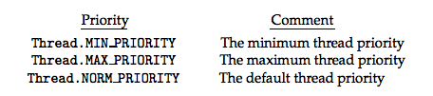
Java Scheduling
Priorities - values range from 1-10
MIN_PRIORITY is 1
NORM_PRIORITY is 5
MAX_PRIORITY is 10

Slide 41
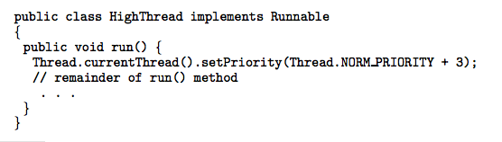
Java Scheduling
Changing priority using setPriority()

Slide 42
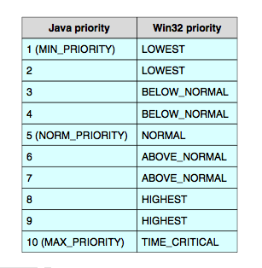
Java Scheduling
Relationship between Java and Win32 Priorities

Slide 43
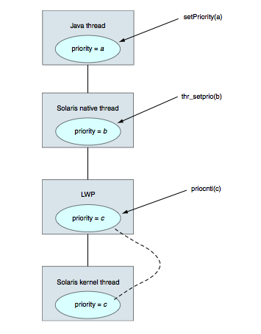
Java Scheduling
Java thread scheduling on Solaris

Slide 44
Algorithm Evaluation
Deterministic modeling – takes a particular predetermined workload and defines the performance of each algorithm for that workload
Queueing models
Implementation

Slide 45

Algorithm Evaluation
Evaluation of CPU schedulers by simulation

Slide 46


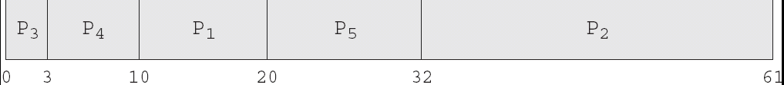
Algorithm Evaluation

Slide 47
End of Chapter 5

